Slide 1
Unit-3
Chapter 8: Main Memory

Slide 2
Chapter 8: Memory Management
Background
Swapping
Contiguous Memory Allocation
Segmentation
Paging
Structure of the Page Table

Slide 3

1. Background
To increase performance, we must keep several processes in memory i.e. we must share memory.
Memory consist of large array of words or bytes, each with its own address.
Instruction-execution cycle fetches
  CPU fetches an instruction from memory.
  Then it is decoded & may cause operands to be fetched from memory.
  After the instruction has been executed on the operands , results may be stored back in memory.

Slide 4
Continue…
Program must be brought (from disk) into memory and placed within a process for it to be run
Main memory and registers are only storage CPU can access directly
Memory unit only sees a stream of addresses + read requests, or address + data and write requests
Register access in one CPU clock (or less)
Cache sits between main memory and CPU registers
Protection of memory required to ensure correct operation

Slide 5
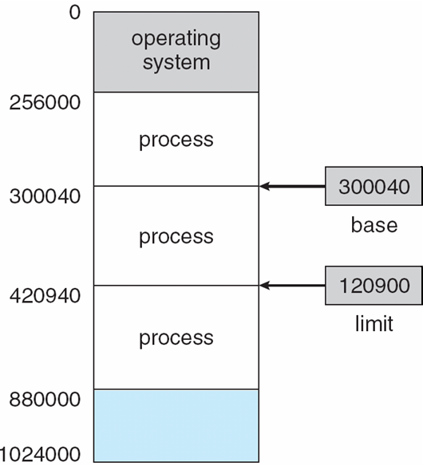
1.1 Base and Limit Registers
Each process must have separate address space.
We can provide this protection by using 2 registers- Base & Limit registers.
Base register holds the smallest legal physical memory address.
Limit register specifies size of the range.
CPU must check every memory access generated in user mode to be sure it is between base and limit for that user
A base & a limit register define a logical address space

Slide 6
Hardware Address Protection with Base and Limit Registers
Protection of memory

Slide 7
1.2 Address Binding
Programs resides on disk & for execution placed within a Process, the processes ready to be brought into memory for execution form an input queue
Although the address space of the computer starts at 00000, the first address of the use space need not be 00000.
Further, addresses may be represented in different ways at different stages of a program’s life
  Address in Source program are usually symbolic( such as count).
  A compiler will bind these symbolic addresses relocatable addresses.
    i.e. “14 bytes from beginning of this module”
  Linker or loader will bind relocatable addresses to absolute addresses
    i.e. 74014
  Each binding maps one address space to another

Slide 8
Binding of Instructions and Data to Memory
Address binding of instructions and data to memory addresses can happen at three different stages
  Compile time: If memory location known at a priori, absolute code can be generated; must recompile code if starting location changes.
  Load time: Must generate relocatable code if memory location is not known at compile time
  Execution time: If the process can be moved during its execution from one memory segment to another, then binding must be delayed until run time.
    Need hardware support for address maps (e.g., base and limit registers)

Slide 9
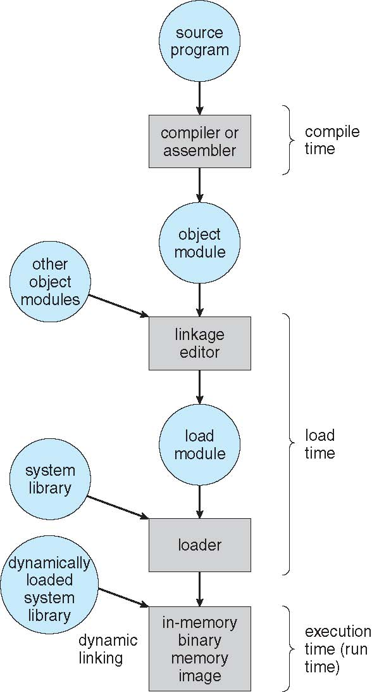
Multistep Processing of a User Program

Slide 10
1.3 Logical vs. Physical Address Space
The concept of a logical address space that is bound to a separate physical address space is central to proper memory management
  Logical address – generated by the CPU; also referred to as virtual address
  Physical address – address seen by the memory unit
Logical and physical addresses are the same in compile-time and load-time address-binding schemes; logical (virtual) and physical addresses differ in execution-time address-binding scheme
Logical address space is the set of all logical addresses generated by a program
Physical address space is the set of all physical addresses generated by a program

Slide 11
Memory-Management Unit (MMU)
The run time mapping from Virtual to Physical address is done by a hardware device called Memory Management Unit (MMU).
To start, consider simple scheme where the value in the relocation register is added to every address generated by a user process at the time it is sent to memory
  Base register now called relocation register
  MS-DOS on Intel 80x86 used 4 relocation registers
The user program deals with logical addresses; it never sees the real physical addresses
  Execution-time binding occurs when reference is made to location in memory
  Logical address bound to physical addresses

Slide 12
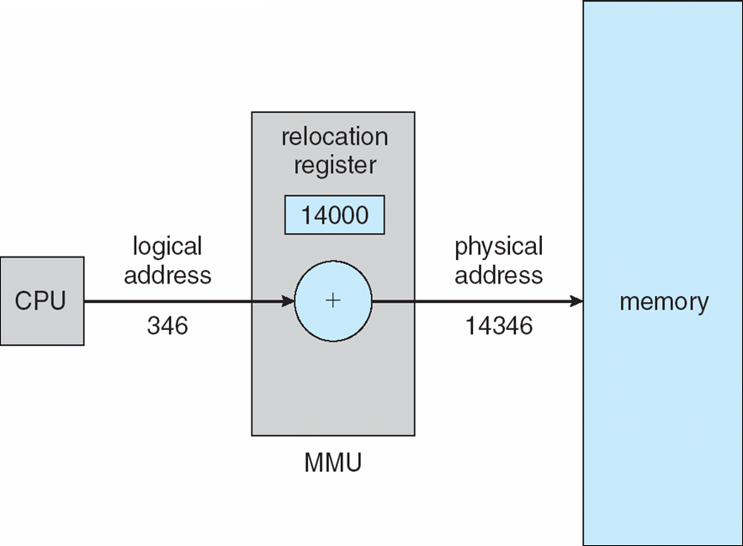
Dynamic relocation using a relocation register
1.4 Dynamic Loading
Routine is not loaded until it is called
Advantages:- Better memory-space utilization; unused routine is never loaded
All routines kept on disk in relocatable load format
Useful when large amounts of code are needed to handle infrequently occurring cases
No special support from the operating system is required
  Implemented through program design
  OS can help by providing libraries to implement dynamic loading

Slide 13
1.5 Dynamic Linking
Static linking – system libraries and program code combined by the loader into the binary program image
Dynamic linking –linking postponed until execution time
Small piece of code, stub, used to locate the appropriate memory-resident library routine
Stub replaces itself with the address of the routine, and executes the routine
Operating system checks if routine is in processes’ memory address
  If not in address space, add to address space

Slide 14
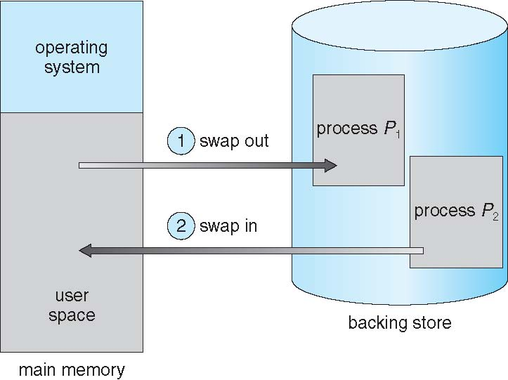
2. Swapping
A process can be swapped temporarily out of memory to a backing store, and then brought back into memory for continued execution (RR & priority scheduling)
Backing store - fast disk large enough to accommodate copies of all memory images
Roll in & Roll out - swapping variant used for priority-based scheduling algorithms
System maintains a ready queue of ready-to-run processes which have memory images on disk

Slide 15
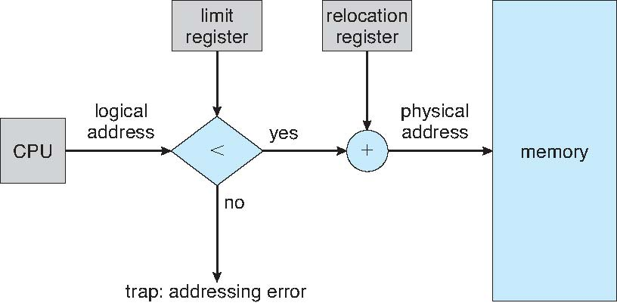
3.Contiguous Allocation
Main memory must support both OS and user processes.
Hence Limited resource must allocate efficiently.
Contiguous allocation is one early method.
We usually want several user processes to reside in memory at the same time.
In Contiguous memory allocation, each process contained in single contiguous section of memory.
Main memory usually divided into two partitions:
  One for Resident operating system, usually held in low memory with interrupt vector.
  & one for the User processes that held in high memory.
Hardware Support for Relocation
and Limit Registers

Slide 16
3.1 Memory Allocation
Simplest method for allocating memory is to divide the memory into fixed size partitions.
Each partition contain exactly one Process.
Multiple-partition method allocation
  Degree of multiprogramming limited by number of partitions
  Variable-partition method indicating which part of memory are available & which one is occupied.
  Hole – block of available memory; holes of various size are scattered throughout memory
  When a process arrives, it is allocated memory from a hole large enough to accommodate it
  Process exiting frees its partition, adjacent free partitions combined
  Operating system maintains information about:
  a) allocated partitions b) free partitions (hole)

Slide 17
Contiguous Allocation (Cont.)
OS
OS
OS
OS
process 5
process 5
process 5
process 5
process 9
process 9
process 8
process 10
process 2
process 2
process 2
process 2
Dynamic Storage allocation Problem

Slide 18
3.2 Dynamic Storage-Allocation Problem
How to satisfy a request of size n from a list of free holes?
First-fit: Allocate the first hole that is big enough
Best-fit: Allocate the smallest hole that is big enough; must search entire list, unless ordered by size
  Produces the smallest leftover hole
Worst-fit: Allocate the largest hole; must also search entire list
  Produces the largest leftover hole which may be used for Best fit strategy.
First-fit and best-fit better than worst-fit in terms of speed and storage utilization.

Slide 19
3.3 Fragmentation
External Fragmentation – total memory space exists to satisfy a request, but it is not contiguous
  Both first fit & best fit suffers from this.
  First fit analysis reveals that given N blocks allocated, 0.5 N blocks lost to fragmentation
    Hence 1/3 of the memory may be unusable which is known as 50-percent rule
Internal Fragmentation – allocated memory may be slightly larger than requested memory; this size difference is memory internal to a partition, but not being used

Slide 20
3.4 Solution to Fragmentation
Reduce external fragmentation by compaction
  Shuffle memory contents to place all free memory together in one large block
  Compaction is possible only if relocation is dynamic, and is done at execution time
  This scheme is expensive.
Another solution is to permit the logical address space of the process to be noncontiguous thus allowing a process to be allocated physical memory whenever available.
  Can be achieved by
    Paging technique
    Segmentation Technique
    Combined

Slide 21
4. Segmentation
It is a Memory-management scheme that supports user view of memory.
It separates user’s view from actual physical memory.
A program is a collection of segments
  A segment is a logical unit such as:
main program
procedure
function
method
object
local variables, global variables
common block
stack
symbol table
arrays

Slide 22
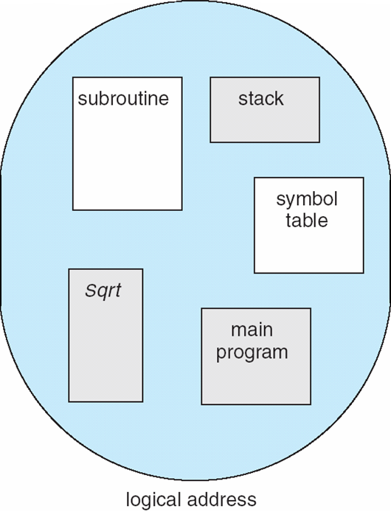
User’s View of a Program

Slide 23
Logical View of Segmentation
1
1
4
2
3
4
2
3
user space
physical memory space
Logical address space is a collection of segments

Slide 24
Segmentation Architecture
Logical address consists of a two tuple :
<segment-number(s), offset(d)>,
Segment table – maps two-dimensional physical addresses; each table entry has:
  Segment base – contains the starting physical address where the segments reside in memory
  Segment limit – specifies the length of the segment

Slide 25
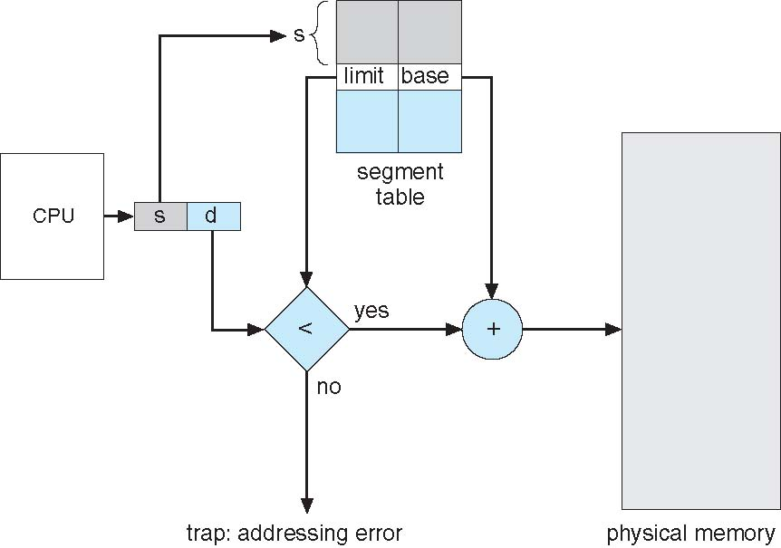
Logical address : segmentation number + offset
Segmentation number used as index to segment table
The offset d must be between 0 & segment limit
If off set is legal then added to segment base otherwise trap generated.
Segmentation Hardware

Slide 26
5. Paging
It permits physical address space of a process to be noncontiguous ; here process is allocated physical memory whenever the latter is available
  Avoids external fragmentation
  Avoids problem of fitting varying sized memory chunks onto backing store.
Basic Method
Divide physical memory into fixed-sized blocks called frames
  Size is power of 2, between 512 bytes and 16 Mbytes per page.
Divide logical memory into blocks of same size called pages
Keep track of all free frames
To run a program of size N pages, need to find N free frames and load program
Set up a page table to translate logical to physical addresses
Backing store likewise split into pages
Still have Internal fragmentation

Slide 27
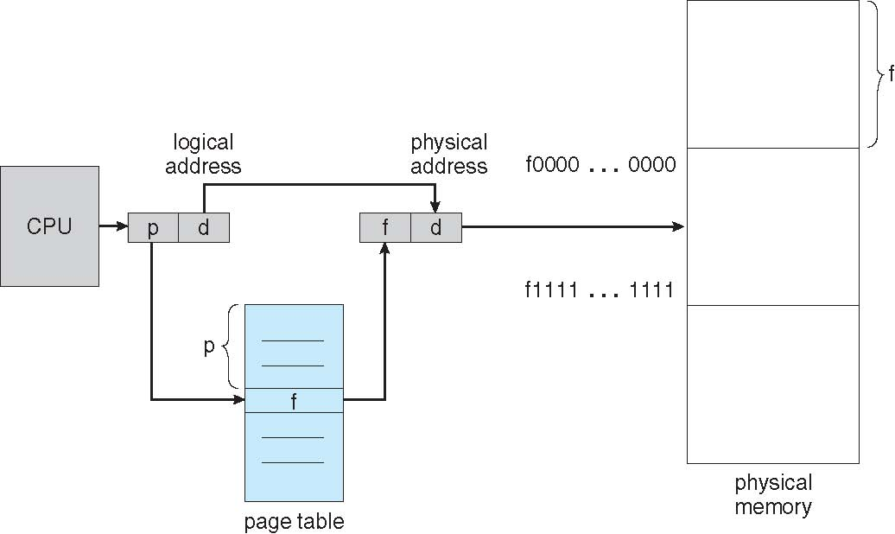
Paging Hardware
Support for paging has been handled by Hardware
Address generated by CPU is divided into:
  Page number (p) – used as an index into a page table which contains base address of each page in physical memory
  Page offset (d) – combined with base address to define the physical memory address that is sent to the memory unit
page number
page offset
p
d
  For given logical address space 2^{m} and page size 2^{n}
m - n
n

Slide 28
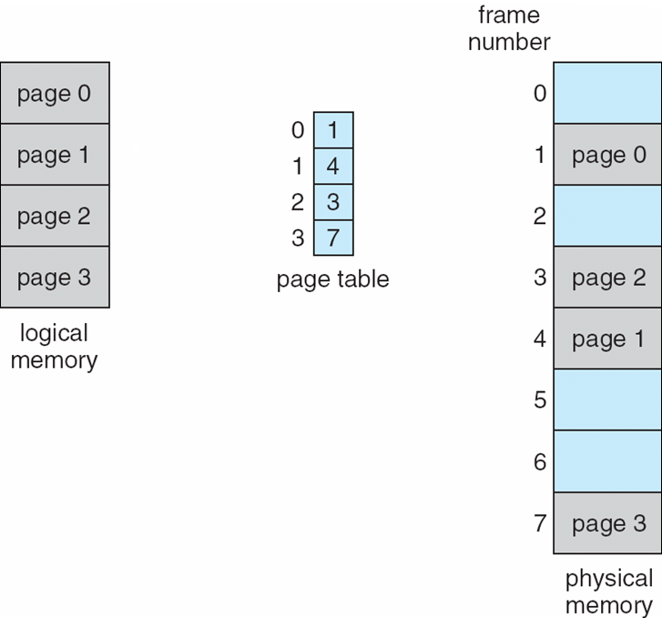
Paging Model of Logical and Physical Memory
If
size of logical address space :- 2^{m}
& a Page size :- 2^{n}
Then high order m-n bits :- Page number
& n low order bits :- Page offset

Slide 29
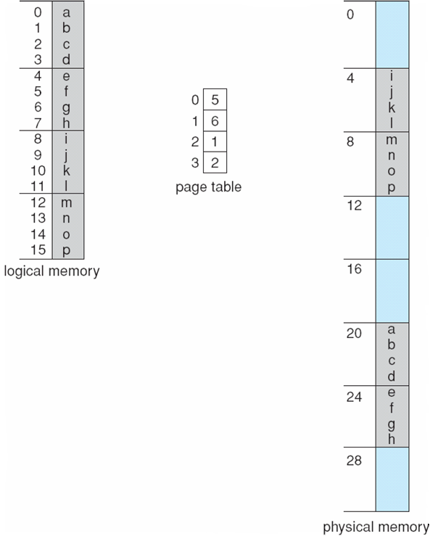
Paging Example
Indexing into page table
Logical address : n=2 and m=4;
Paging example for
Physical memory :- 32-byte memory
Page Size :- 4-byte pages
Example:
Logical address 0 = Page 0 & Offset 0
Indexing shows Page 0 is in Frame 5
Thus logical address 0 maps to the physical address 20 [=(5*4)+0]
Logical address 3 :- [=(5*4)+3] :- 20
Logical address 13 :- [=(2*4)+1] :- 9
Shows Page0 is in Frame5..etc

Slide 30
Paging (Cont.)
Calculating internal fragmentation
  Page size = 2,048 bytes
  Process size = 72,766 bytes
  35 pages + 1,086 bytes
  Internal fragmentation of 2,048 - 1,086 = 962 bytes
  In worst case if a process need n pages with 1 byte extra
  Then n+1 frames would be allocated
  Resulting Worst case fragmentation = 1 frame – 1 byte
  On average fragmentation = 1 / 2 frame size
  So small frame sizes desirable?
  But each page table entry takes memory to track
  Page sizes growing over time
    Solaris supports two page sizes – 8 KB and 4 MB

Slide 31
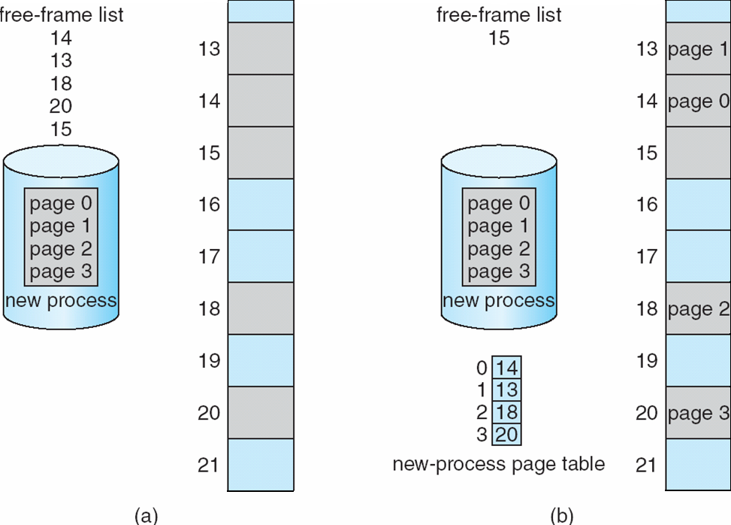
Free Frames
Before allocation
After allocation

Slide 32
Implementation of Page Table
Page table is kept in main memory
Page-table base register (PTBR) points to the page table
Page-table length register (PTLR) indicates size of the page table
In this scheme every data/instruction access requires two memory accesses
  One for the page table and one for the data / instruction
The two memory access problem can be solved by the use of a special fast-lookup hardware cache called associative memory or translation look-aside buffers (TLBs)
TLB is associative high speed memory consist of 2 parts a Key & a Value.
TLBs typically small (64 to 1,024 entries)
If the page number is not in the TLB then it is called TLB miss.
On a TLB miss, value is loaded into the TLB for faster access next time
  Replacement policies must be considered
  Some entries can be wired down for permanent fast access

Slide 33
Associative Memory
Associative memory – parallel search
Address translation (p, d)
  If p is in associative register, get frame # out
  Otherwise get frame # from page table in memory
Page #
Frame #

Slide 34
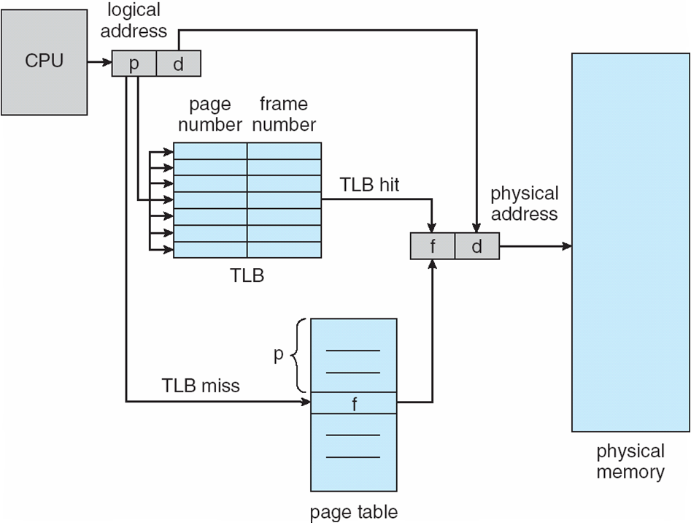
Paging Hardware With TLB

Slide 35
Memory Protection
Memory protection implemented by associating protection bit with each frame to indicate if read-only or read-write access is allowed
  Can also add more bits to indicate page execute-only, and so on
Valid-invalid bit attached to each entry in the page table:
  “valid” indicates that the associated page is in the process’ logical address space, and is thus a legal page
  “invalid” indicates that the page is not in the process’ logical address space
  Or use page-table length register (PTLR)
Any violations result in a trap to the kernel

Slide 36
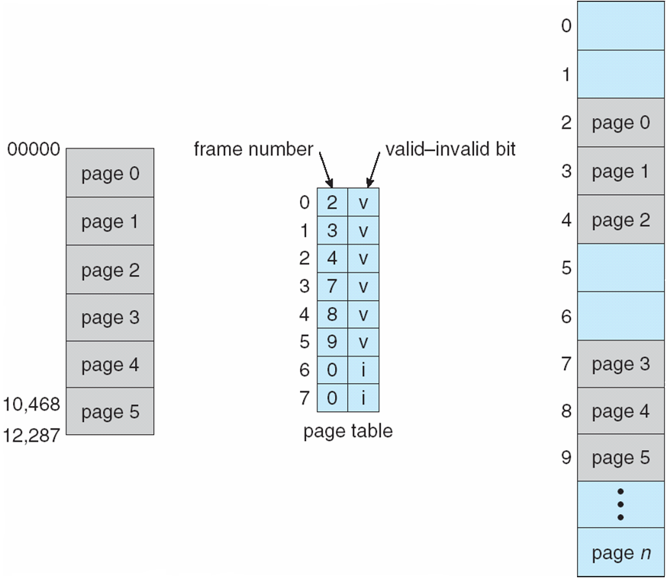
Valid (v) or Invalid (i) Bit In A Page Table

Slide 37
Shared Pages
Shared code
  One copy of read-only (reentrant) code shared among processes (i.e., text editors, compilers, window systems)
  Similar to multiple threads sharing the same process space
  Also useful for interprocess communication if sharing of read-write pages is allowed
Private code and data
  Each process keeps a separate copy of the code and data
  The pages for the private code and data can appear anywhere in the logical address space

Slide 38
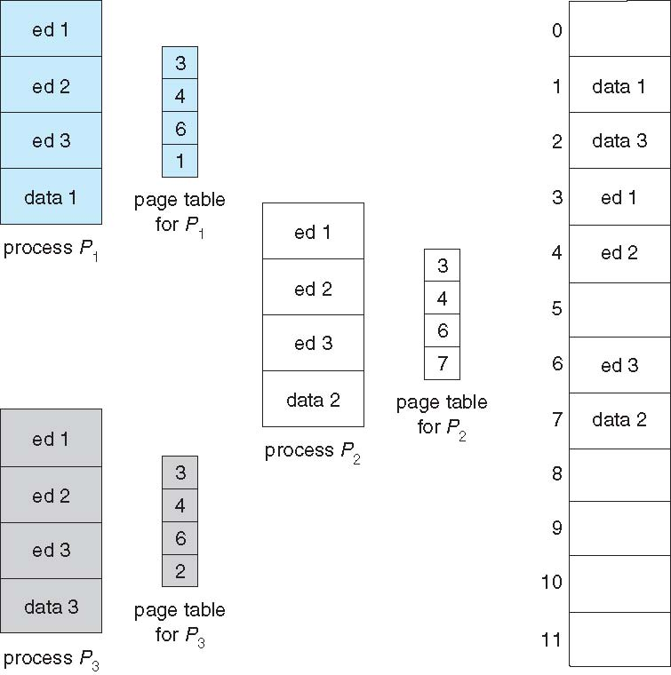
Shared Pages Example
Consider a system that support 40 users
Each executes a Text Editor
If text editor :- 150KB & data space:- 50KB
Then we need 8000KB to support 40 users.
If the code is REENTRANT or PURE code, we can share it.
Example :
Here we see 3 Editor with 50KB page size each.
With this scheme we need to store only one copy of each editor but data pages are mapped onto different frames.
Thus here we need only one copy of Editor(150KB) plus 40 copies of the 50 KB data space.

Slide 39
Structure of the Page Table
Most common Techniques are :
Hierarchical Paging
Hashed Page Tables
Inverted Page Tables

Slide 40
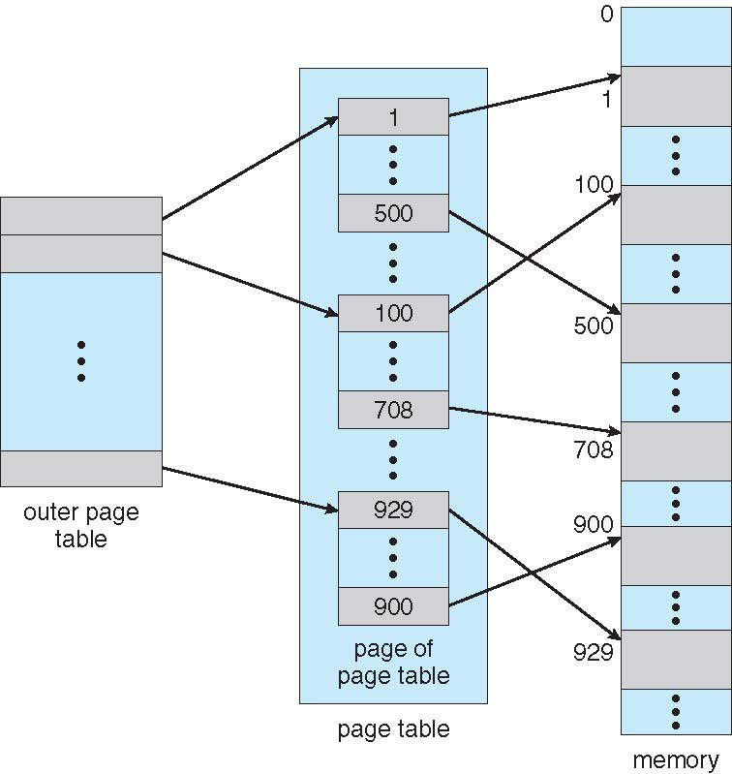
Hierarchical Page Tables
Many computer system support a large address space
In such situation , we Break up the logical address space into multiple page tables
A simple technique is a two-level page table
In this page table itself also paged.

Slide 41
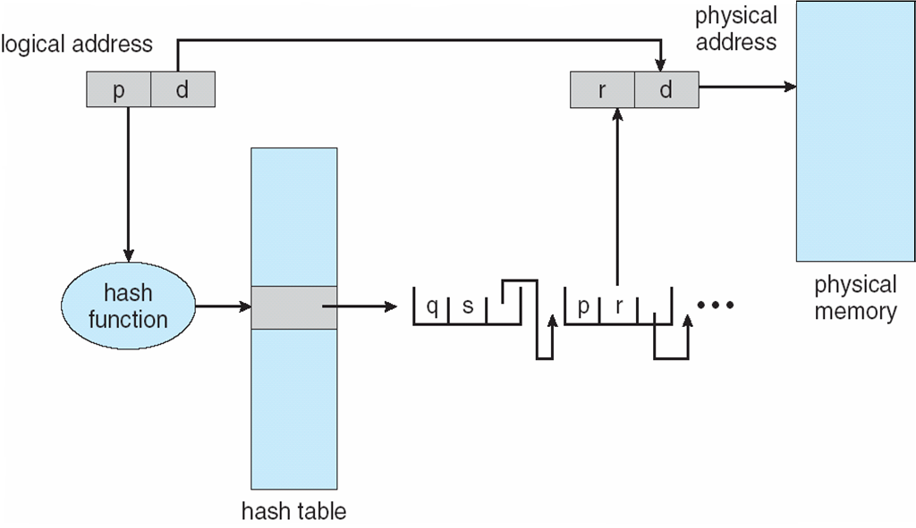
Hashed Page Tables
Used for handling address spaces larger than 32 bits.
Here Hash value being the Virtual page number.
Each entry in Hash table contains linked list of elements that hash to same location.
Each element contains (1) the virtual page number (2) the value of the mapped page frame (3) a pointer to the next element
Variation for 64-bit addresses is clustered page tables
  Similar to hashed but each entry refers to several pages (such as 16) rather than 1
  Especially useful for sparse address spaces (where memory references are non-contiguous and scattered)
Field 1: Virtual page no is compared
Field 2: If there is a match, the corresponding page frame used for physical address

Slide 42
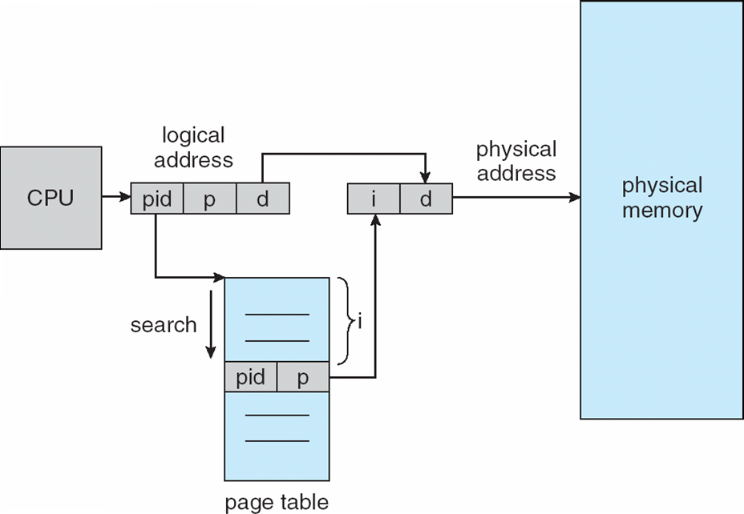
Inverted Page Table
Rather than each process having a page table and keeping track of all possible logical pages, track all physical pages
One entry for each real page of memory
Entry consists of the virtual address of the page stored in that real memory location, with information about the process that owns that page
Thus only one page table is in the system & it has only one entry for each page of physical memory
Each virtual address consist of <process-id , page number, offset>
Each inverted table page entry consist of <process-id , page number>
Decreases memory needed to store each page table, but increases time needed to search the table when a page reference occurs

Slide 43


